Slide 1
description

Slide 2
description
A technical description conveys information about a product or mechanism to someone who will use it, operate it, assemble it, or manufacture it, or to someone who needs to know more about it.
Description is the pattern of narrative development that aims to make a clear picture of a place, object, character, or group. Descriptive technical writing uses a combination of visuals and text to both “show” and “tell” the reader about the information being conveyed.
Descriptive writing is about using the power of words to arouse the imagination, capture the attention, and create a lasting impact in the mind of the reader

Slide 3
Descriptions and definitions often go hand in hand and provide the foundation for many types of technical explanation.
Definitions answer the questions
"What is it?"
"What does it entail?"
Descriptions answer additional questions that include
"What does it look like?“
"What are its parts?"
"What does it do?“
"How docs it work?"
"How does it happen?"

Slide 4
Technical descriptions can take many forms, depending on purpose and audience.
Descriptions can range from a brief sentence, to a paragraph, a whole section of a report, or an entire manual.
Poorly written technical descriptions can cause confusion, waste time, and even result in catastrophe!
Technical product descriptions are often legally required to ensure safety and compliance. Attention to detail is critical.

Slide 5
Mechanism description
Mechanism Descriptions provide a detailed overview the physical aspects of a tool, machine or other mechanical device that has moving parts and is designed to perform a specific function. These could be product descriptions for sales or manufacturing, documentation of design specifications, information manual etc.
Mechanism descriptions should provide a clear understanding of the object being described, including
General appearance and physical properties
Overall function/purpose
Component parts
How the parts interact to create a functioning whole.

Slide 6
Mechanism description
The reader should be able to clearly picture, and therefore understand, the nature of the object being described, what it does, and how it works.
In order to achieve this clarity for the reader, the writer must choose significant details and organize information logically.
color | materials | texture, smell, taste
shape | component parts | Finish
Size | Properties | patterns, designs
dimensions | principles at work | Interactions

Slide 7
Depending on the reader’s need, the description may range from a general overview requiring only a few sentences to a multi-chapter manual detailing every aspect of the mechanism’s parts and functions in order to troubleshoot technical problems and complete repairs.
Before you begin to draft your description, you must consider your purpose and audience:
Why does your audience need this description?
What will they use it for?
Are you describing different types of solar panels for the average consumers to help them choose the one that best fits their needs?
Are you giving schematics to technicians and installers?

Slide 8
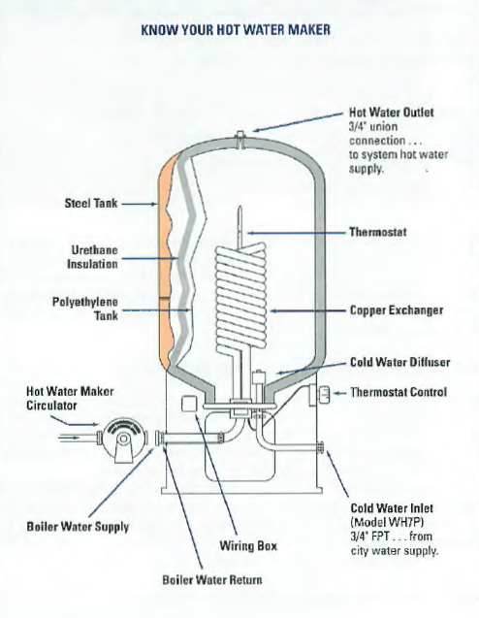

Slide 9
Include the following elements
Once you have your purpose and audience clearly in focus, draft a description that includes the following elements:
Definition: What is it, and what is its main purpose?
Overview: Describe the mechanism’s overall appearance (“big picture”).
Components: Describe the main component parts in labeled sections; consider the order of information carefully here. Create a logical connection between each component described.
Explanation: how do the parts work together to fulfill its function? What key principles govern its functioning? Consider how much detail is necessary here for your intended audience.
Visuals: include graphics that clearly illustrate the mechanism and/or its parts. Show the device as a whole; consider showing specific details in expanded views, cut-away, or labeled diagrams. You may even embed or link to videos showing the device in action.

Slide 10
Include the following elements
Conclusion: depending on the purpose, you might review product’s history, availability, manufacturing, costs, warnings, etc.)
References: Sources you have used in your description, or additional sources of information available (if relevant).

Slide 11
Process Descriptions
It details a series of events (natural/biological/ecological, mechanical, social, or psychological phenomenon) that happen in particular sequence in order to achieve a specific outcome.
These can be categorized into non-instructional processes (such as a process analyses of how an internal combustion engine works, or natural processes like photosynthesis) and instructional process (such as recommended/required procedures and explicit step-by-step instructions to be followed).

Slide 12
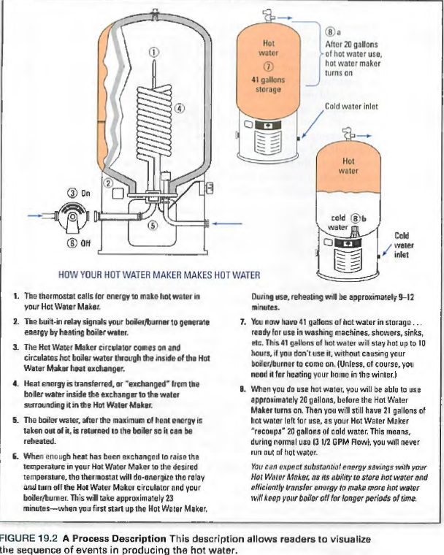

Slide 13
definitions
Definitions: clarify the specific meaning, often related to a specific context, or express the essential nature of the terms being defined.
These can range in length from a simple clarifying phrase to an extended document of several pages. Definitions will often include detailed descriptions and visuals to illustrate ideas.

Slide 14
Consider the following
Organization: Use a logical principle to organize your description
Language: Use specific, precise, concrete terms – avoid vague or overly-general terms
Use appropriate level of detail
Use correct terminology – define terms as necessary for your audience
Use analogy to describe an unfamiliar thing in terms of a familiar thing
Use objective language
Use present tense, active verbs to describe how the device appears and what it does
Use words that create vivid and specific pictures in the reader’s mind.
Use visuals

